Slide 1

PWM Drawer Project
BY: Eslam ayman Amin
Supervised by: amit

Slide 2
Content
PWM Meaning
Frequency and Duty Cycle
PWM in ATMEGA32
Project Aim
Project Procedures
Project Output

Slide 3
PWM Meaning
PWM stands for Pulse Width Modulation
Avoids noisy signals
Used in digital devices

Slide 4
PWM meaning
The digital signal is about zeros and ones.
A microcontroller sends the volts:
5V or 3.3V as ones
0V as zeros

Slide 5

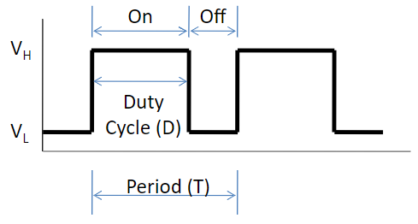

Frequency and duty cycle
Frequency is number of cycles per second.
$Frequency= \frac{1}{Time}$
Duty Cycle is the percentage of ON state over a period.
$Duty Cycle= \frac{T_{ON}}{Time }×100$

Slide 6
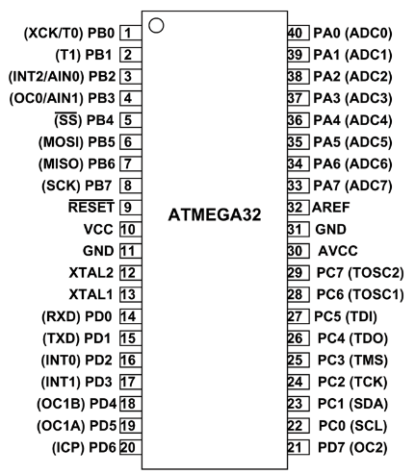
PWM in atmega32
Use timers (Timer 0/1/2)
Timer 0 and Timer 2 have same functions.
Timer 0/2 – 8 bits.
Timer 1 – 16 bits.
Timer mode is PWM

Slide 7
Project AIM
Calculate Frequency
Calculate Duty Cycle
Draw the Pulse

Slide 8
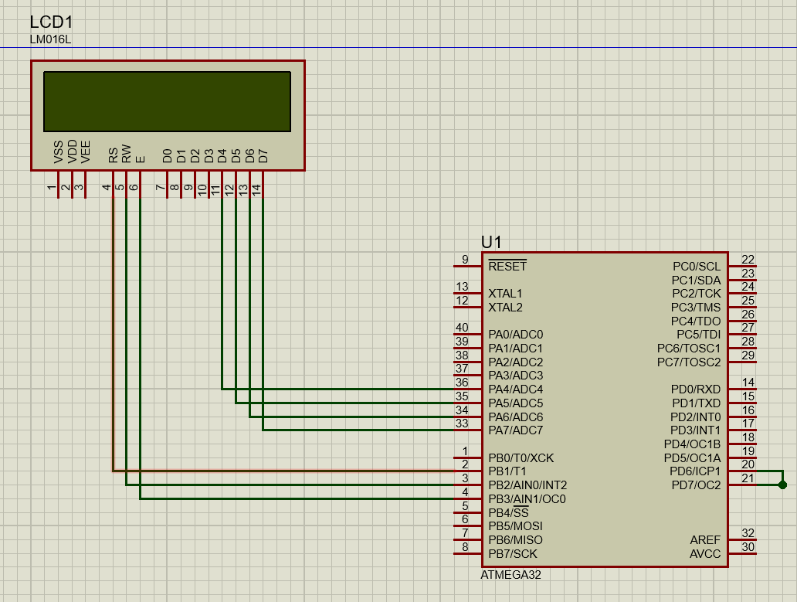
Project procedures
Connect LCD pins to AVR.
Use Timer2 to generate a pulse.
Use Timer1 as input capture unit.
Connect input capture pin to Timer2 pin.

Slide 9
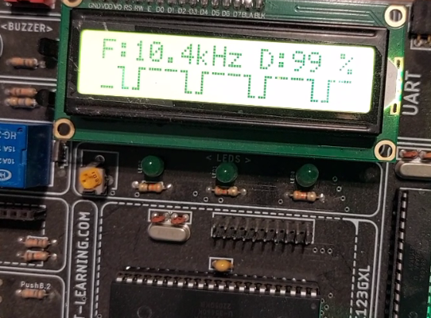
Project output

Slide 10
Thank you
By: Eslam Ayman Amin
email: eslamayman13@hotmail.com

Slide 11
REFERENCES
ATMEGA32 Datasheet

